Slide 1
Memory
By: Vivek Sharma

Slide 2
Memory Hierarchy
Pr
ocessor
Fastest access is to the data held in
processor registers. Registers are at
the top of the memory hierarchy.
Relatively small amount of memory that
can be implemented on the processor
chip. This is processor cache.
Two levels of cache. Level 1 (L1) cache
is on the processor chip. Level 2 (L2)
cache is in between main memory and
processor.
Next level is main memory, implemented
as SIMMs. Much larger, but much slower
than cache memory.
Next level is magnetic disks. Huge amount
of inexepensive storage.
Speed of memory access is critical, the
idea is to bring instructions and data
that will be used in the near future as
close to the processor as possible.
Re
gisters
Increasing
Increasing
Increasing
size
speed
cost per bit
Primary
L1
cache
Secondary
L2
cache
Main
memory
Magnetic disk
secondary
memory

Slide 3
Memory Hierarchy Properties:
Information stored in a memory hierarchy (M1, M2,..Mn)
satisfies three important properties:
Inclusion Property: It implies that all information items are originally stored in level Mn. During the processing, subsets of Mn are copied into Mn-1. similarity, subsets of Mn-1 are copied into Mn-2, and so on.
Coherence Property: It requires that copies of the same information item at successive memory levels be consistent. If a word is modified in the cache, copies of that word must be updated immediately or eventually at all higher levels.
Locality of References: The memory hierarchy was developed based on a program behaviour known as locality of references. Memory references are generated by the CPU for either instruction or data access. Frequently used information is found in the lower levels in order to minimize the effective access time of the memory hierarchy.
Temporal locality of reference:
Recently executed instruction is likely to be executed again very soon.
Spatial locality of reference:
Instructions with addresses close to a recently instruction are likely to be executed soon.

Slide 4
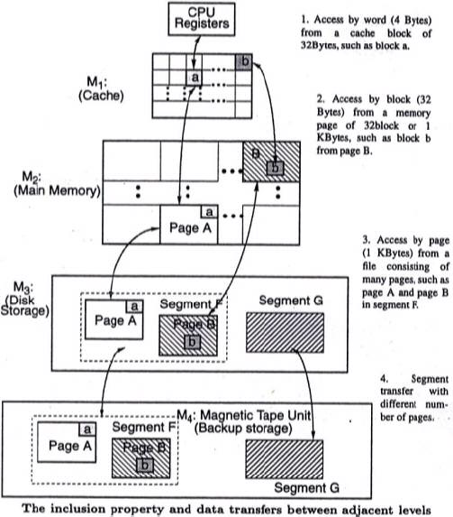

Slide 5
Cache hit
Existence of a cache is transparent to the processor. The processor issues Read and Write requests in the same manner.
If the data is in the cache it is called a Read or Write hit.
Read hit:
The data is obtained from the cache.
Write hit:
Cache has a replica of the contents of the main memory.
Contents of the cache and the main memory may be updated simultaneously. This is the write-through protocol.
Update the contents of the cache, and mark it as updated by setting a bit known as the dirty bit or modified bit. The contents of the main memory are updated when this block is replaced. This is write-back or copy-back protocol.

Slide 6
Cache miss
If the data is not present in the cache, then a Read miss or Write miss occurs.
Read miss:
Block of words containing this requested word is transferred from the memory.
After the block is transferred, the desired word is forwarded to the processor.
The desired word may also be forwarded to the processor as soon as it is transferred without waiting for the entire block to be transferred. This is called load-through or early-restart.
Write-miss:
Write-through protocol is used, then the contents of the main memory are updated directly.
If write-back protocol is used, the block containing the addressed word is first brought into the cache. The desired word is overwritten with new information.
Notes:
6

Slide 7
Mapping functions
Mapping functions determine how memory blocks are placed in the cache.
A simple processor example:
Cache consisting of 128 blocks of 16 words each.
Total size of cache is 2048 (2K) words.
Main memory is addressable by a 16-bit address.
Main memory has 64K words.
Main memory has 4K blocks of 16 words each.
Three mapping functions:
Direct mapping
Associative mapping
Set-associative mapping.

Slide 8
Direct mapping
Main
Block 0
Block j of the main memory maps to j modulo 128 of
the cache. 0 maps to 0, 129 maps to 1.
More than one memory block is mapped onto the same
position in the cache.
May lead to contention for cache blocks even if the
cache is not full.
Resolve the contention by allowing new block to
replace the old block, leading to a trivial replacement
algorithm.
Memory address is divided into three fields:
- Low order 4 bits determine one of the 16
words in a block.
- When a new block is brought into the cache,
the the next 7 bits determine which cache
block this new block is placed in.
- High order 5 bits determine which of the possible
32 blocks is currently present in the cache. These
are tag bits.
Simple to implement but not very flexible.
memory
Cache
Block 1
tag
Block 0
tag
Block 1
Block 127
Block 128
tag
Block 127
Block 129
T
ag
Block
W
ord
Block 255
5
7
4
Block 256
Main memory address
Block 257
Block 4095
Notes:
8

Slide 9
Associative mapping
Main
Block 0
memory
Main memory block can be placed into any cache
position.
Memory address is divided into two fields:
- Low order 4 bits identify the word within a block.
- High order 12 bits or tag bits identify a memory
block when it is resident in the cache.
Flexible, and uses cache space efficiently.
Replacement algorithms can be used to replace an
existing block in the cache when the cache is full.
Cost is higher than direct-mapped cache because of
the need to search all 128 patterns to determine
whether a given block is in the cache.
Cache
Block 1
tag
Block 0
tag
Block 1
Block 127
Block 128
tag
Block 127
Block 129
Tag
Word
Block 255
12
4
Block 256
Main memory address
Block 257
Block 4095
Notes:
9

Slide 10
Set-Associative mapping
Cache
Main
Blocks of cache are grouped into sets.
Mapping function allows a block of the main
memory to reside in any block of a specific set.
Divide the cache into 64 sets, with two blocks per set.
Memory block 0, 64, 128 etc. map to block 0, and they
can occupy either of the two positions.
Memory address is divided into three fields:
- 6 bit field determines the set number.
- High order 6 bit fields are compared to the tag
fields of the two blocks in a set.
Set-associative mapping combination of direct and
associative mapping.
Number of blocks per set is a design parameter.
- One extreme is to have all the blocks in one set,
requiring no set bits (fully associative mapping).
- Other extreme is to have one block per set, is
the same as direct mapping.
memory
Block 0
tag
Block 0
Block 1
tag
Block 1
tag
Block 2
tag
Block 3
Block 63
Block 64
tag
Block 126
Block 65
tag
Block 127
T
ag
Block
W
ord
Block 127
5
7
4
Block 128
Main memory address
Block 129
Block 4095
Notes:
10

Slide 11
Direct Mapping
MM Size | Cache size | Block Size | Tag bits in PA | Tag Directory Size
128KB | 16KB | 256B
32GB | 32KB | 1KB
 | 512KB | 1KB | 7
16GB |  | 4KB | 10
64MB |  |  | 10
 | 512KB |  | 7

Slide 12
Associative Mapping
MM Size | Cache size | Block Size | Tag bits in PA | Tag Directory Size | No. of Comparator
128KB | 16KB | 256B
32GB | 32KB | 1KB
 | 512KB | 1KB | 7
16GB |  | 4KB | 10
64MB |  |  | 10
 | 512KB |  | 7

Slide 13
Set- Associative Mapping
MM Size | Cache size | Block Size | Tag bits in PA | Tag Directory Size | No. of Comparator | Set- Associative
128KB | 16KB | 256B |  |  |  | 2 way
32GB | 32KB | 1KB |  |  |  | 4 way
 | 512KB | 1KB | 7 |  |  | 8 way
16GB |  | 4KB | 10 |  |  | 4 way
64MB |  |  | 10 |  |  | 4 way
 | 512KB |  | 7 |  |  | 8 way

Slide 14
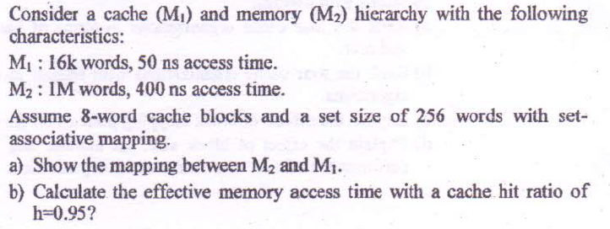

Slide 15
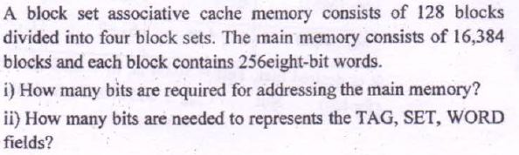

Slide 16
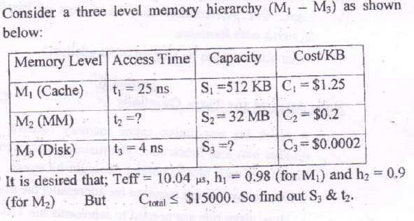

Slide 17
Unified v Split Caches
One cache for data and instructions or two, one for data and one for instructions
Advantages of unified cache
Higher hit rate
Balances load of instruction and data fetch
Only one cache to design & implement
Advantages of split cache
Eliminates cache contention between instruction fetch/decode unit and execution unit
Important in pipelining

Slide 18
Logical vs. Physical Address Space
The concept of a logical address space that is bound to a separate physical address space is central to proper memory management
Logical address – generated by the CPU; also referred to as virtual address
Physical address – address seen by the memory unit
Logical and physical addresses are the same in compile-time and load-time address-binding schemes; logical (virtual) and physical addresses differ in execution-time address-binding scheme
Logical address space is the set of all logical addresses generated by a program
Physical address space is the set of all physical addresses generated by a program
Notes:
18

Slide 19
Paging
Physical address space of a process can be noncontiguous; process is allocated physical memory whenever the latter is available
Avoids external fragmentation
Avoids problem of varying sized memory chunks
Divide physical memory into fixed-sized blocks called frames
Size is power of 2, between 512 bytes and 16 Mbytes
Divide logical memory into blocks of same size called pages
Keep track of all free frames
To run a program of size N pages, need to find N free frames and load program
Set up a page table to translate logical to physical addresses
Backing store likewise split into pages
Still have Internal fragmentation
Notes:
19

Slide 20
Address Translation Scheme
Address generated by CPU is divided into:
Page number (p) – used as an index into a page table which contains base address of each page in physical memory
Page offset (d) – combined with base address to define the physical memory address that is sent to the memory unit
For given logical address space 2^{m} and page size 2^{n}
Notes:
20

Slide 21
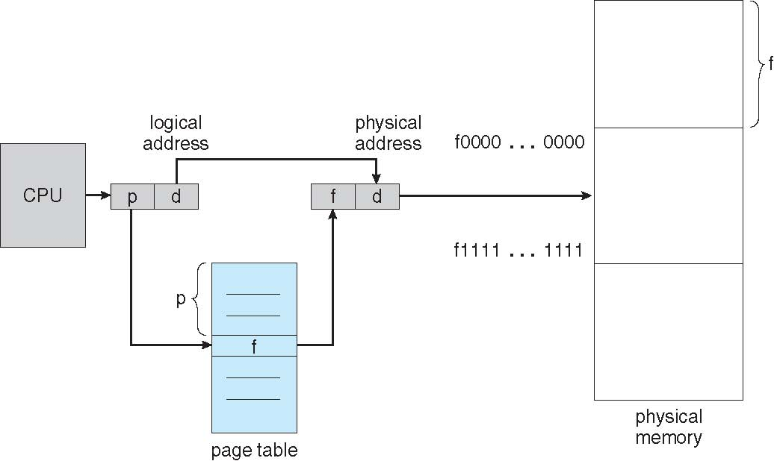
Paging Hardware
Notes:
21

Slide 22

Paging Model of Logical and Physical Memory
Notes:
22

Slide 23

Paging Hardware With TLB
Notes:
23

Slide 24

Valid (v) or Invalid (i) Bit In A Page Table
Notes:
24

Slide 25
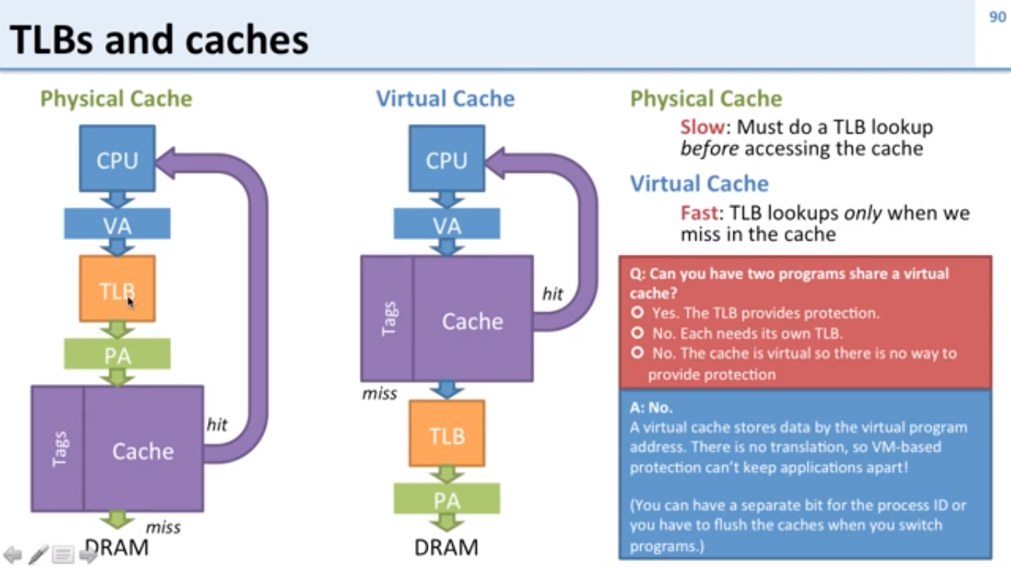
Virtual Address & Physical Address Cache

Slide 26
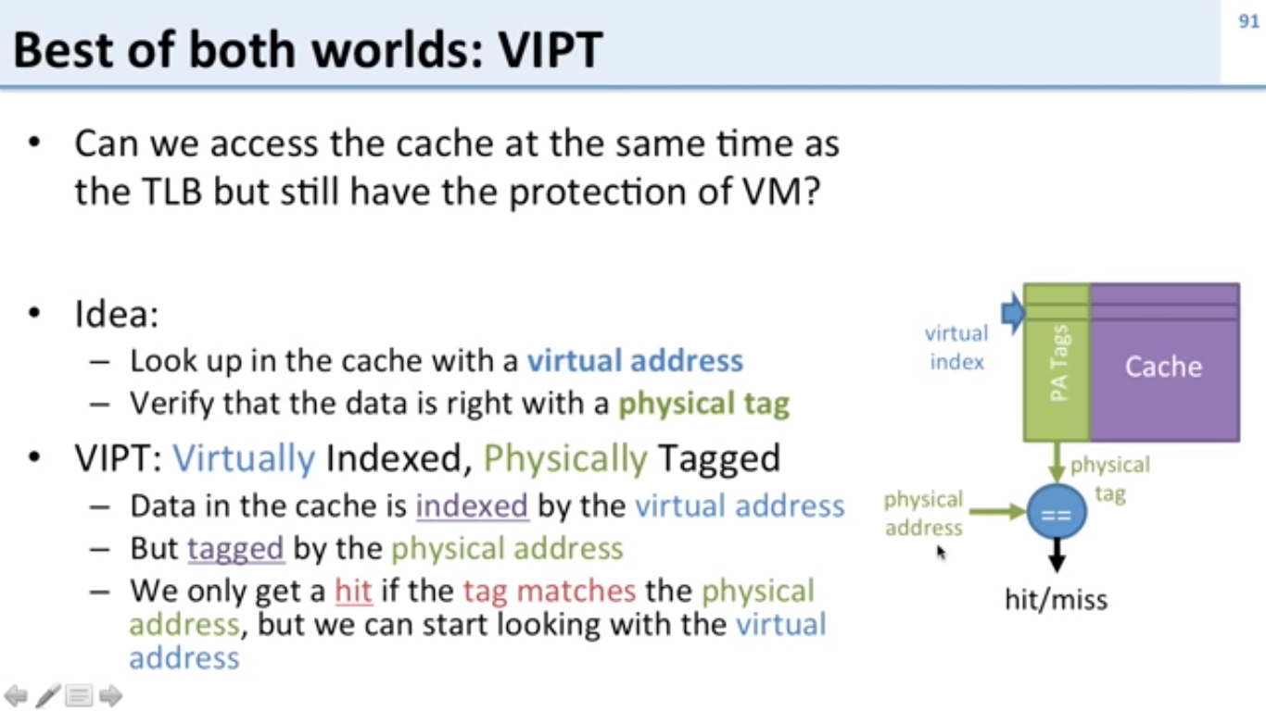

Slide 27
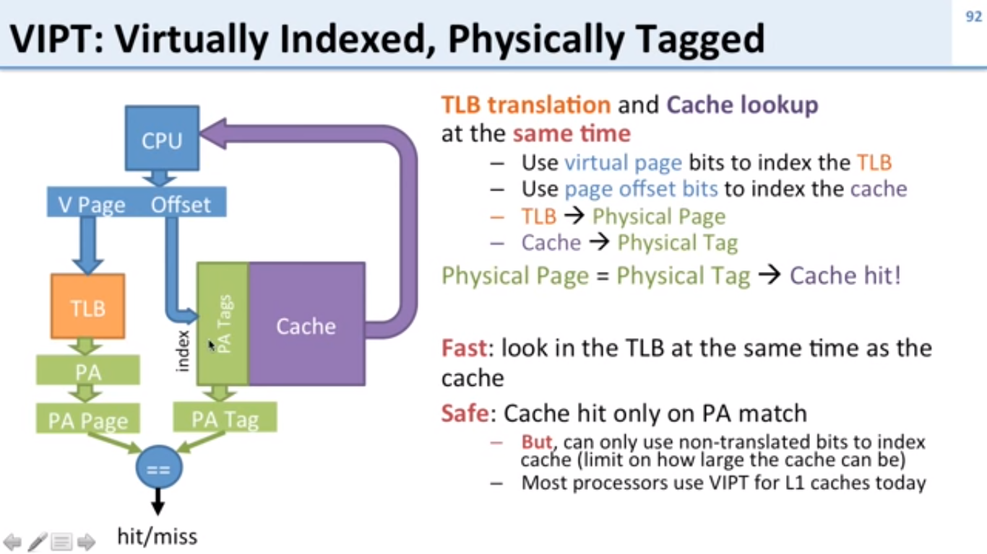

Slide 28
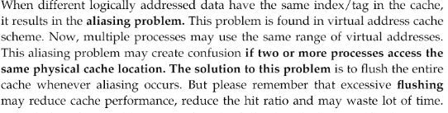
Aliasing Problem

Slide 29
What happens if there is no free frame?
Page replacement – find some page in memory, but not really in use, swap it out
algorithm
performance – want an algorithm which will result in minimum number of page faults
Same page may be brought into memory several times
Notes:
29

Slide 30
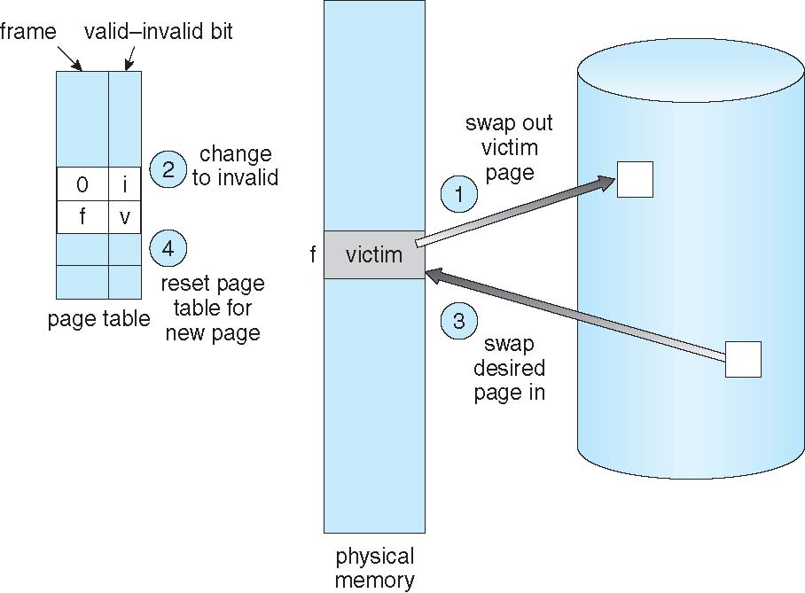
Page Replacement
Notes:
30

Slide 31
Page Replacement Algorithms
Want lowest page-fault rate
Evaluate algorithm by running it on a particular string of memory references (reference string) and computing the number of page faults on that string
In all our examples, the reference string is
1, 2, 3, 4, 1, 2, 5, 1, 2, 3, 4, 5
Notes:
31

Slide 32
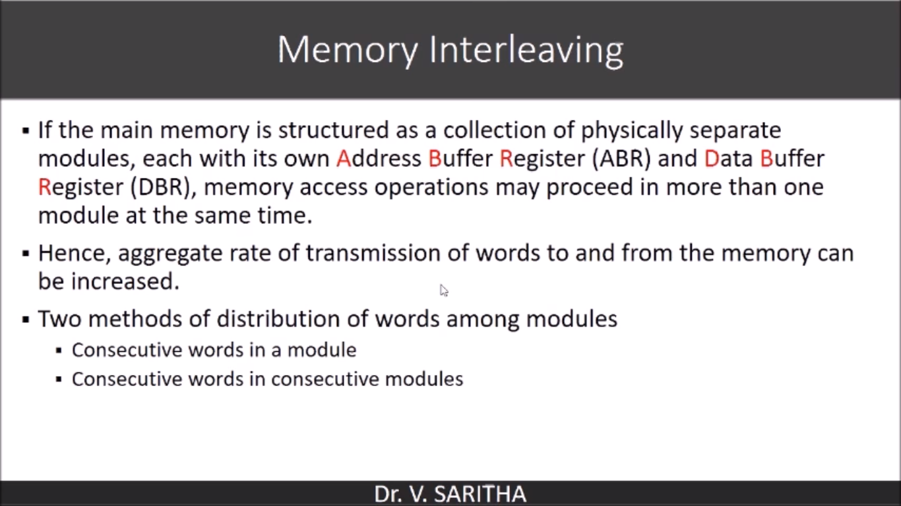

Slide 33
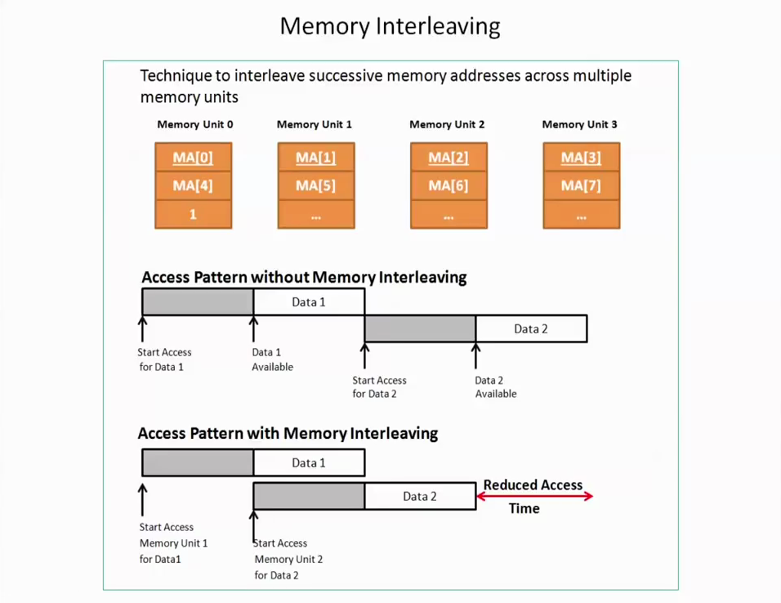

Slide 34
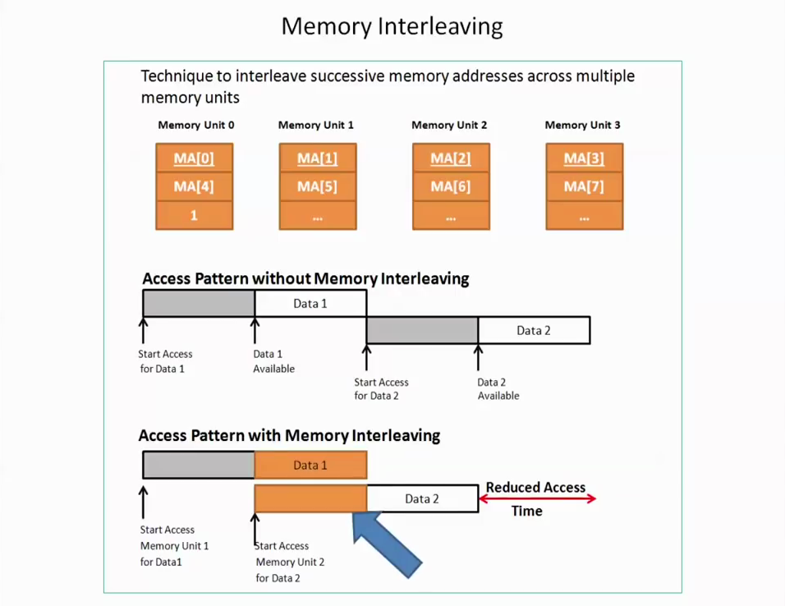

Slide 35
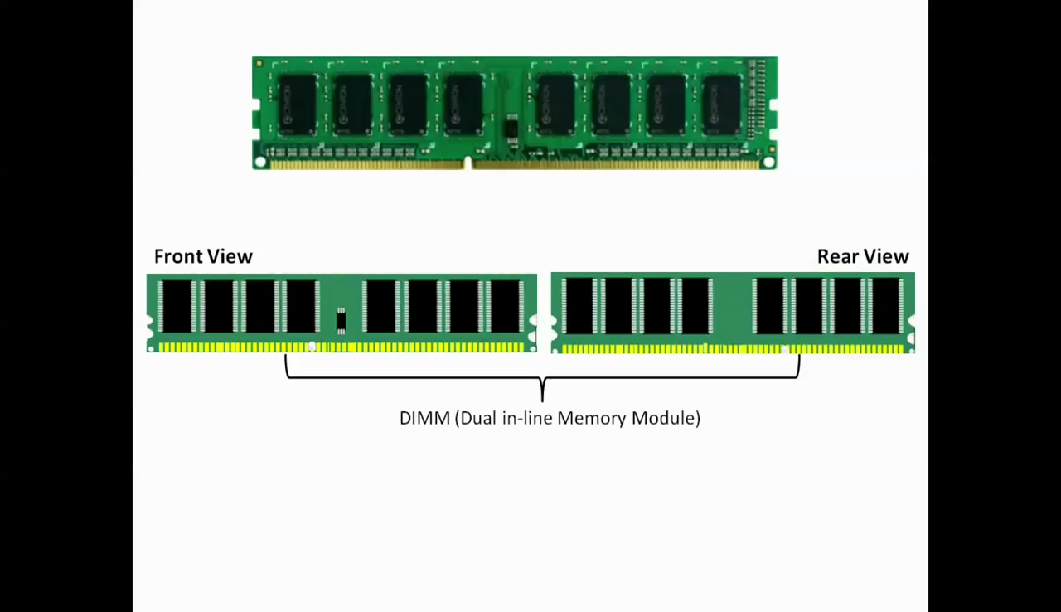

Slide 36
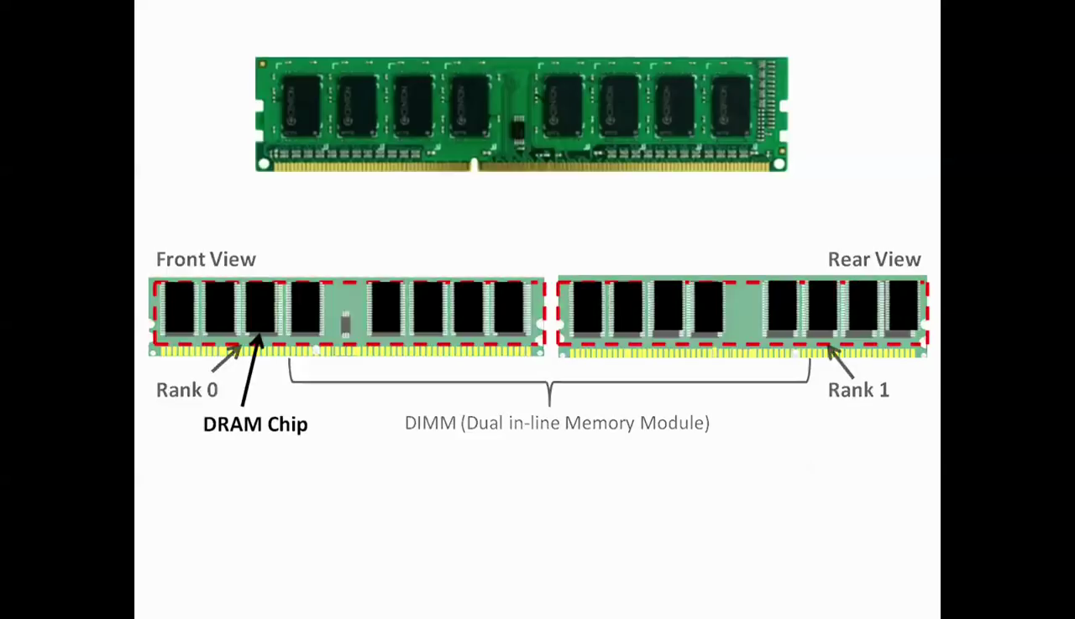

Slide 37
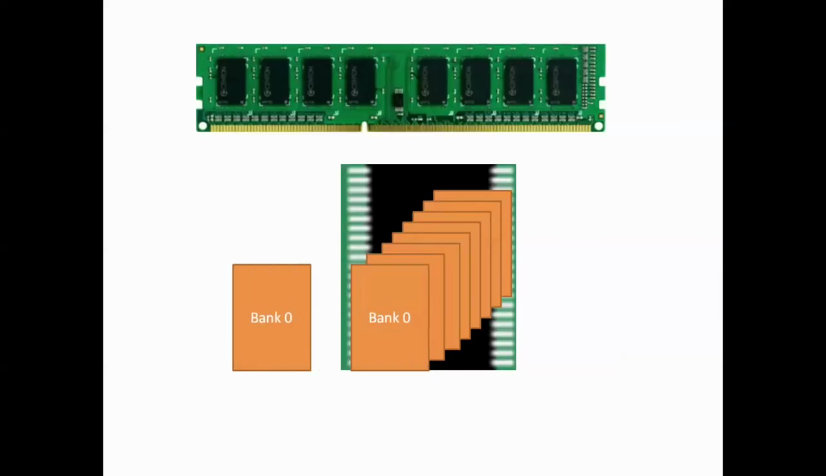

Slide 38
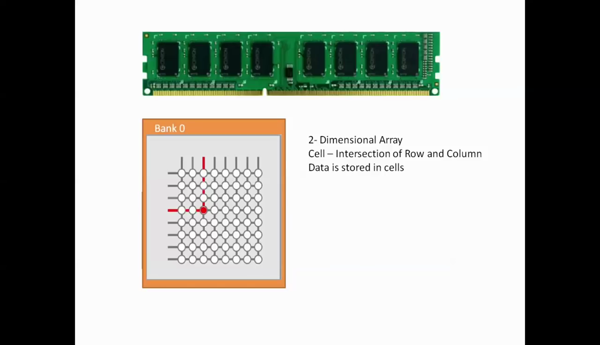

Slide 39
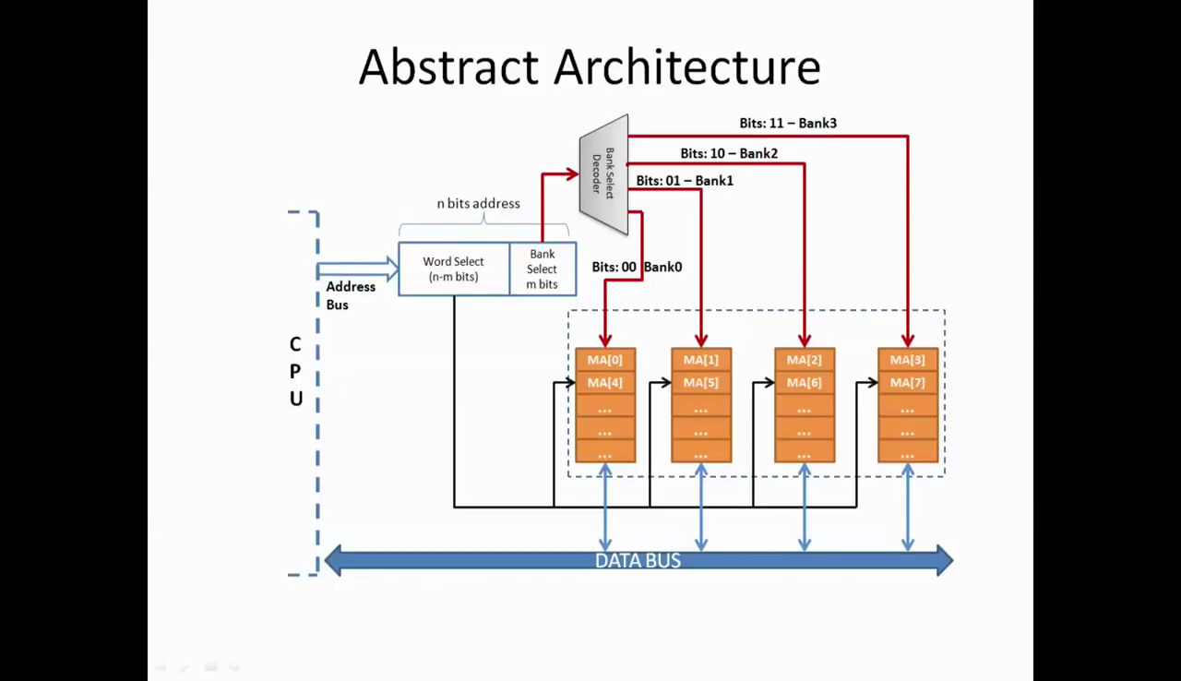

Slide 40
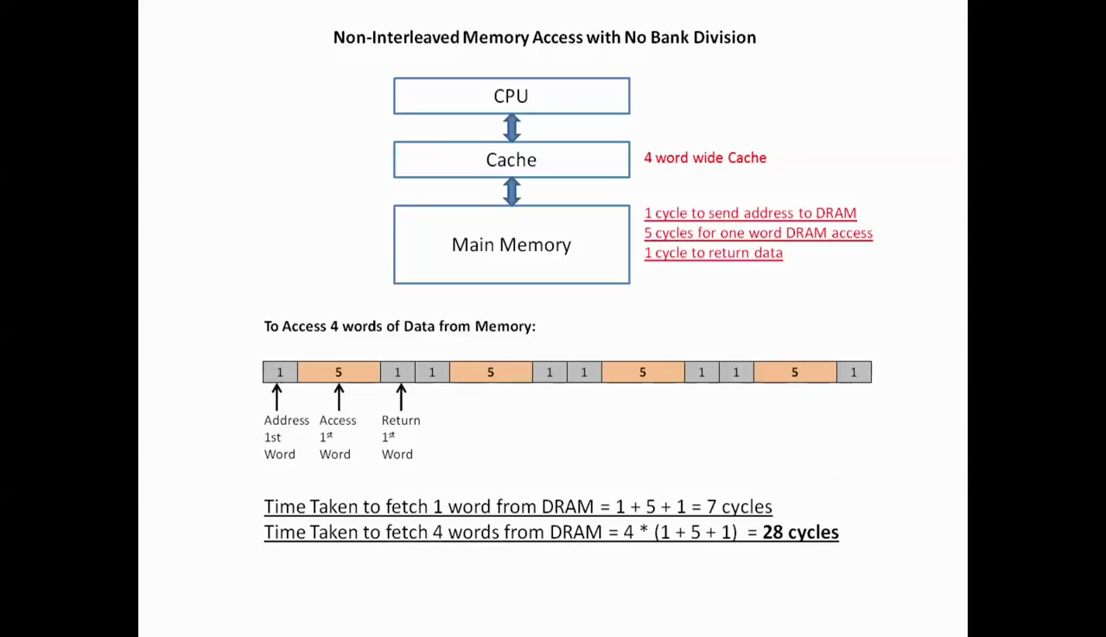

Slide 41
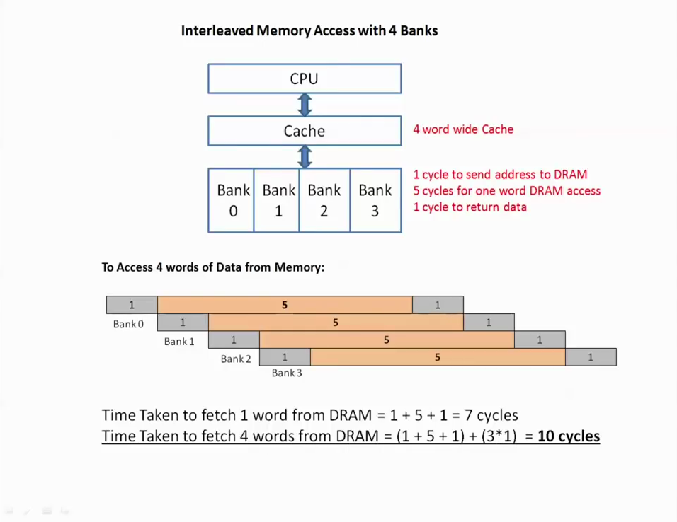

Slide 42
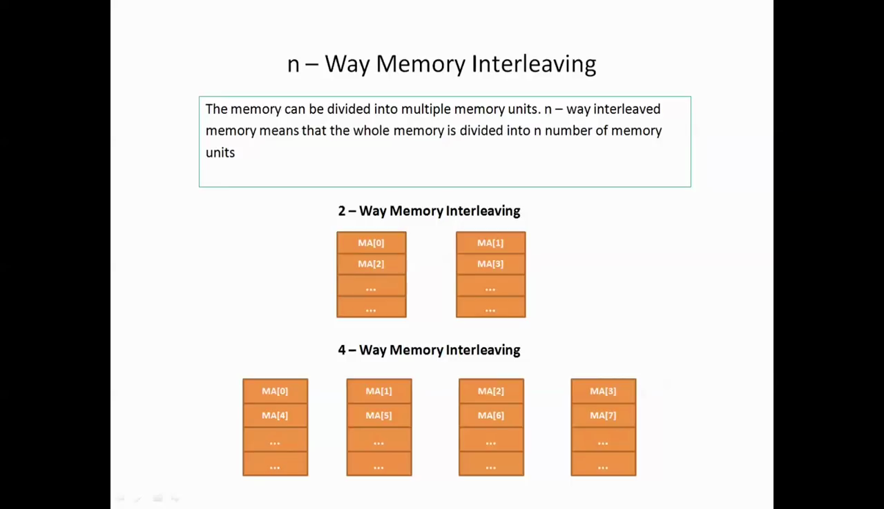

Slide 43
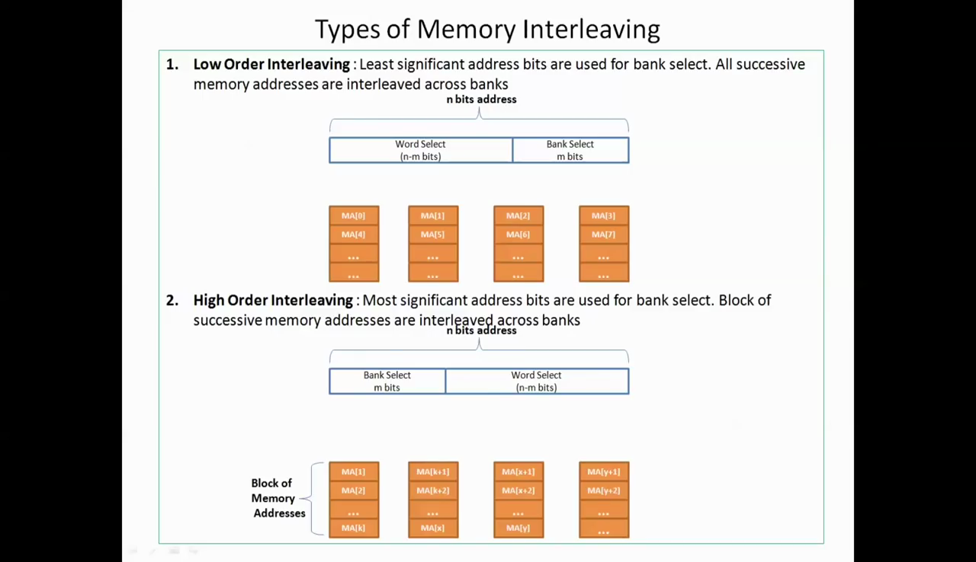

Slide 44
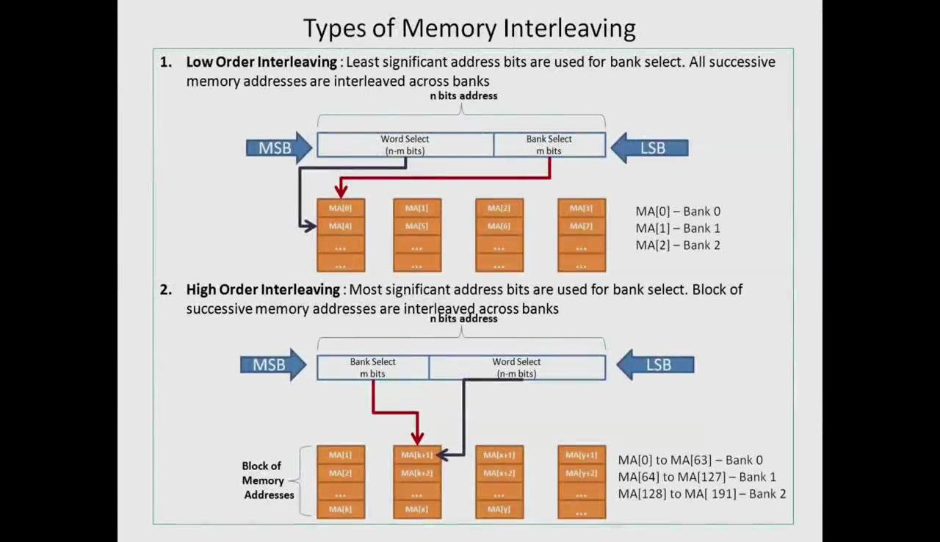

Slide 45
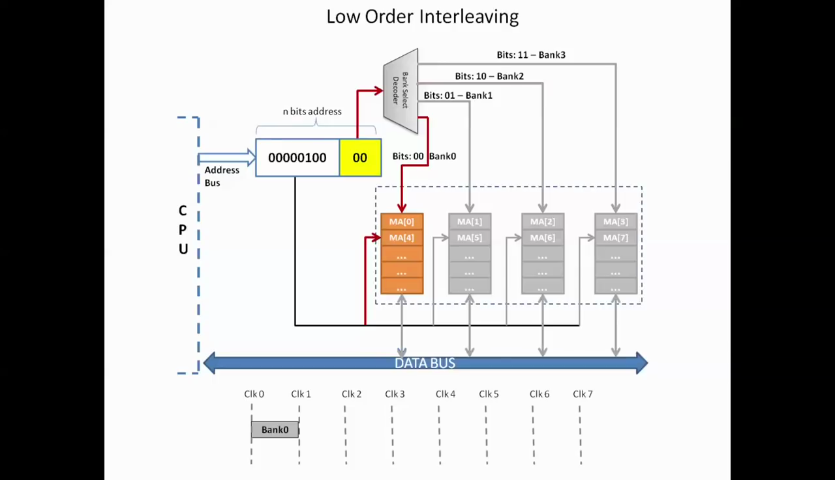

Slide 46
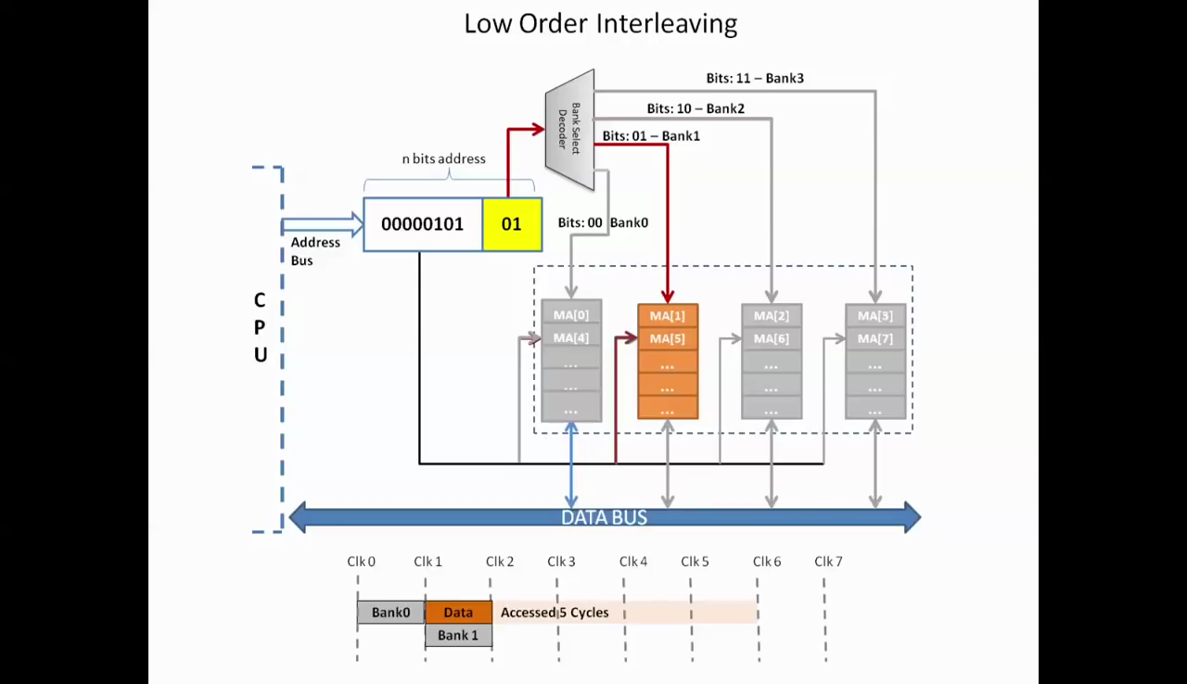

Slide 47
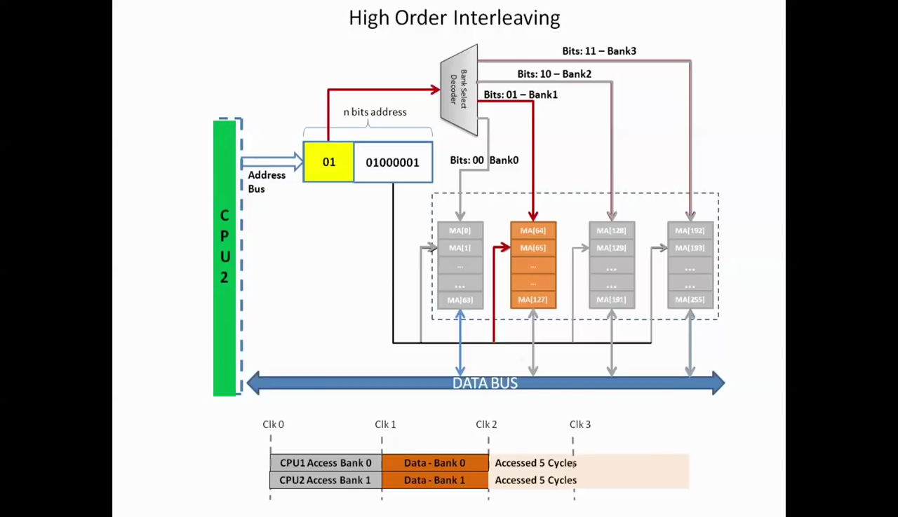

Slide 48
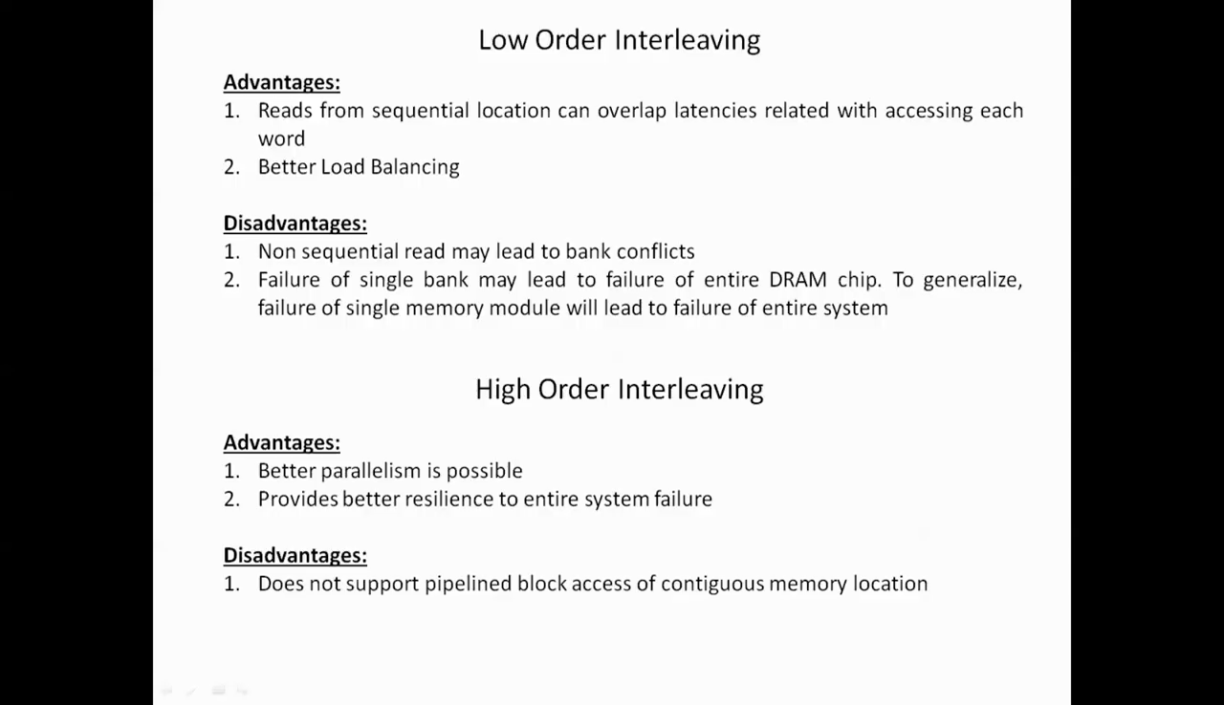

Slide 49
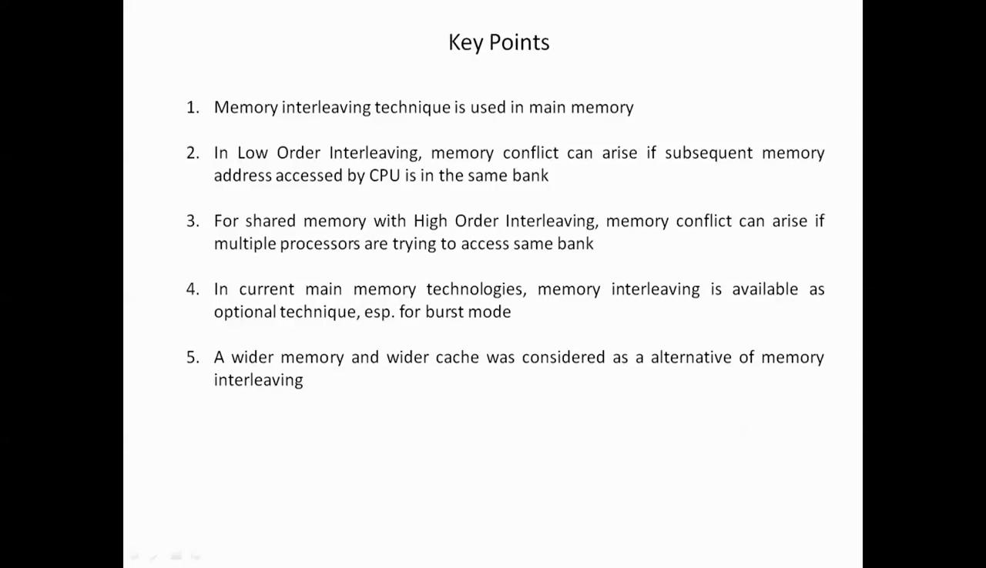

Slide 50
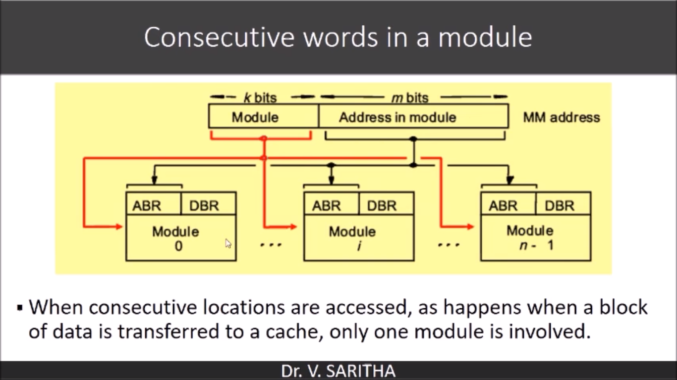

Slide 51
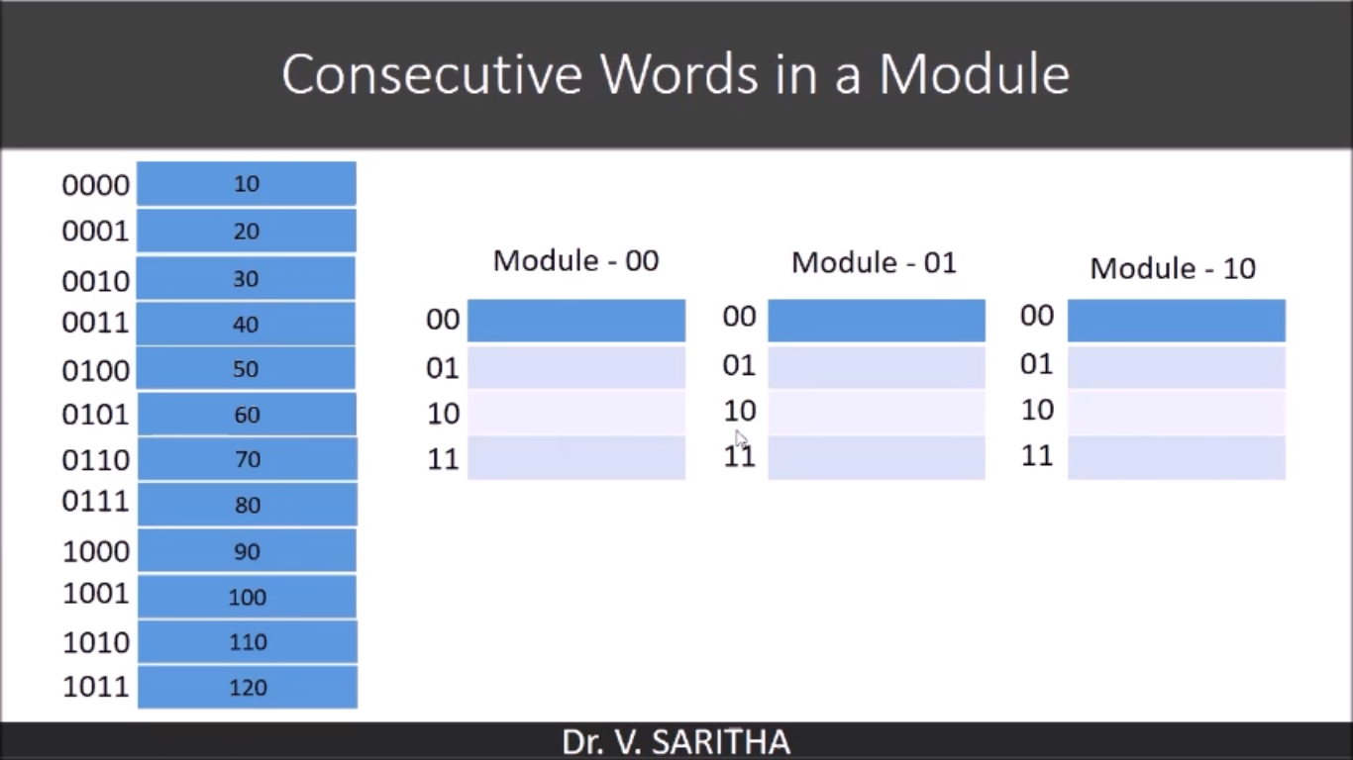

Slide 52
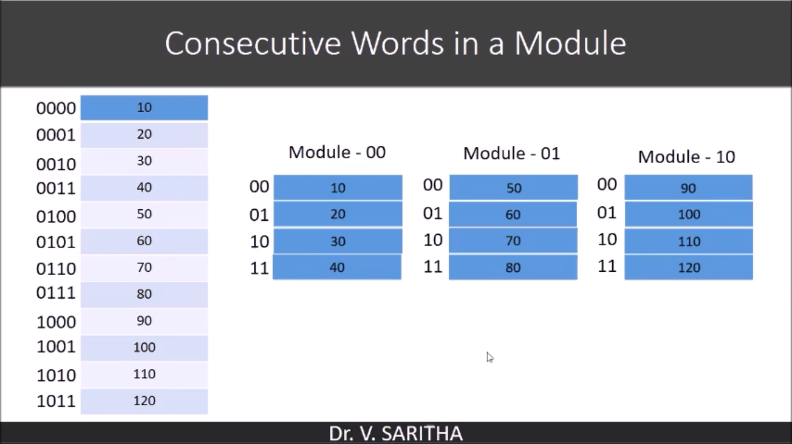

Slide 53
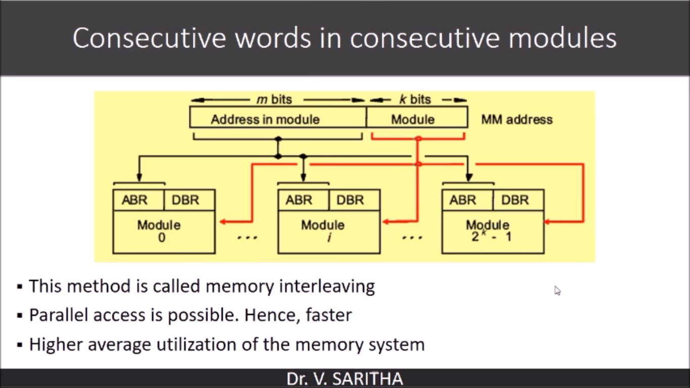

Slide 54
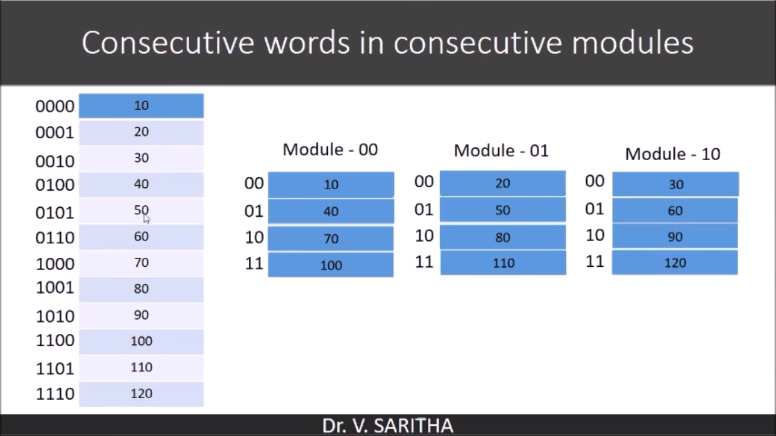

Slide 55
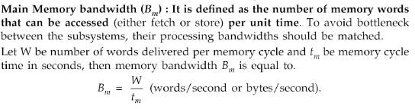
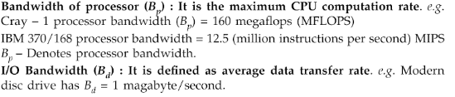
Bandwidth

Slide 56
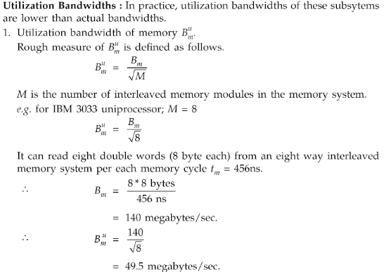

Slide 57
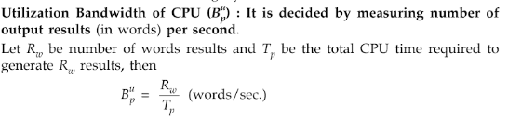
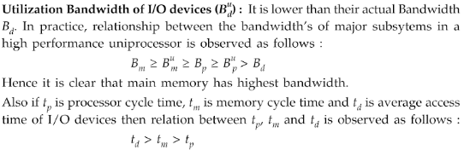

Slide 58
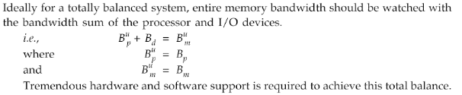

Slide 59
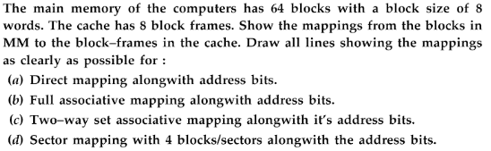

Slide 60
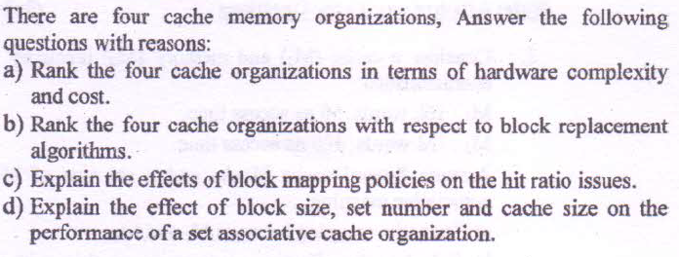

Slide 61
Ans:
Direct mapped cache has lowest cost. Fully associative cache has the highest because an associative search is needed on all the blocks. In set- associative mapping, the associative search is needed within the set. In sector mapping, it is needed to find the sector.
In direct mapped cache, the block replacement is rigid and trivial. Any replacement algorithm can be implemented with any of the three mapping of cache. In Fully associative, the algorithm are applied to the entire cache. In set- associative mapping, only a subset of cache frames are examined.
Direct mapping: Hit ratio is high if the reference pattern leads to uniform distribution of the work set in the cache.
Fully Associative Mapping: Hit ratio is independent of reference pattern.
Set- associative mapping: Hit ratio should be higher than direct mapping and lower than associative mapping.
Sector mapping: Hit ration is sensitive to the reference pattern. When a block in a sector is replaced, the blocks in the same sector are invalidated. This reduces the count of valid blocks residing in the cache.
d) As the block size increases, the hit ration improves because of spatial locality This increase reaches its peak at a certain optimum block size. After this point, hit ratio decreases with increasing block size.
For the fixed cache size, the hit ratio may decrease as the number of sets increases. After 512 set numbers in the cache, the hit ratio decreases at much faster rate.

Slide 62
Q. You are asked to perform capacity planning for two level memory system. M1(cache) has 3 choices- 64KB, 128KB, and 256KB. M2(MM) has 4 MB capacity. Given that: C1= 20C2, t2= 10t1. Cache hit ratios are 0.7, 0.9 and 0.98 respectively for the above 3 choices of M1.
a) Find ta in terms of t1 = 20ns.
b) Find the average byte cost of the entire system if C2= $0.2/ KB.
c) Compare three memory designs.

Slide 63
Q. Consider a MM consisting of 4 memory modules with 256 words per module. Assume 16 words in each cache block. The cache has total capacity of 256 words. The cache is 4 way set associative.
a) Show the address assignment for all 1024 words in four way low order interleaved organization of MM.
b) How many block are there in MM? How many block frames are there in cache?
c) Explain bit fields needed for addressing each word in 2- level memory system.
d) Show the mapping from the blocks in MM to the set in the cache and explain how to use the tag field to locate a block frame within each set?

